Slide 1

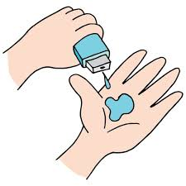
Team Name -- Ideatics
Final Project
Cloud based attendance system

Slide 2
PROJECT TITLE Cloud Based Attendance System Using Face Recognition

Slide 3

AGENDA
Marking up the Attendance physically is one of a major but important concern nowadays for the faculty members of any academic institution. There could be a indefinite human errors while performing this task. And to ensure the feasibility of the process of uploading all the attendance related data on the system is other concern. So to make the process smooth and effective we came up with an idea of Attendance using face recognition. In which a person would be marked as present using their facial features. The system would be using a camera to detect a face and then the recognition system would work to match the person’s face with the database. This system would be useful and effective for academic institutions and would be a great step towards digitalizing the process.

Slide 4

PROBLEM STATEMENT
The human face recognition from video sequences is a challenging task, because there are variations present in background images, facial expression & illumination.
Its Aim is to develop automated attendance system which can capture and mark presence of student.

Slide 5

PROJECT OVERVIEW
A facial recognition system is a technology capable of matching a human face from a digital image or a video frame against a database of faces, typically employed to authenticate users through ID verification services, works by pinpointing and measuring facial features from a given image.
For face recognition there are two types of comparisons:-
1. Verification.
This is where the system compares the given individual with who that individual says they are and gives a yes or no decision.
2. Identification.
This is where the system compares the given individual to all the Other individuals in the database and gives a ranked list of matches.

Slide 6

WHO ARE THE END USERS?
The End users of Our Project is Basically the Government Institution, Big Private Companies and Private Education Powerhouses.

Slide 7

YOUR SOLUTION AND ITS VALUE PROPOSITION
The implementation of face recognition technology includes the following four stages:
Data acquisition
Input processing
Face image classification
Decision making
INPUT PROCESSING
IMAGE CLASSIFICATION
DECISION MAKING
DATA ACQUISITION

Slide 8
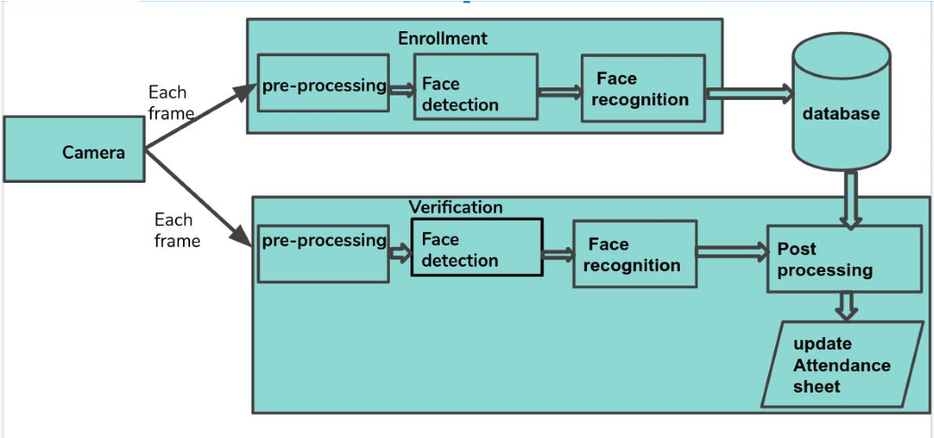
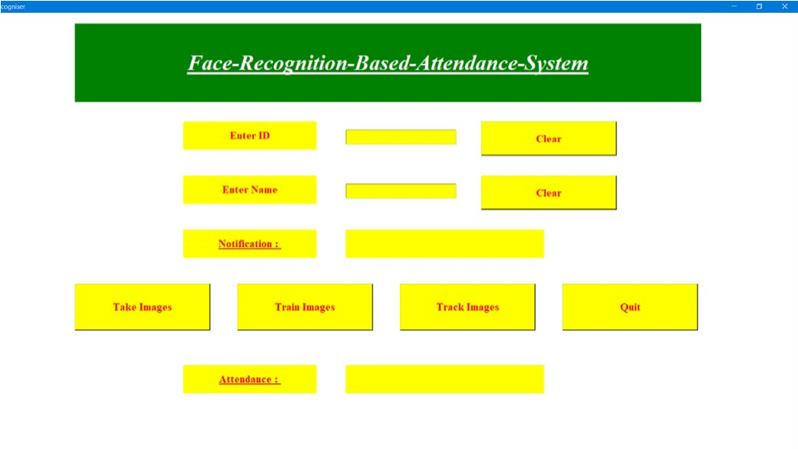

THE WOW IN YOUR SOLUTION

Slide 9
MODELLING
OPEN CV-PYTHON:- OpenCV is a huge open-source library for computer vision, machine learning, and image processing. OpenCV supports a wide variety of programming languages like Python, C++, Java, etc. It can process images and videos to identify objects, faces, or even the handwriting of a human. When it is integrated with various libraries, such as Numpy which is a highly optimized library for numerical operations, then the number of weapons increases in your Arsenal i.e whatever operations one can do in Numpy can be combined with OpenCV.
NUMPY:-NumPy is a Python library used for working with arrays. It also has functions for working in domain of linear algebra, fourier transform, and matrices. NumPy was created in 2005 by Travis Oliphant. It is an open source project and you can use it freely. NumPy stands for Numerical Python.
DLIB:-It's a landmark's facial detector with pre-trained models, the dlib is used to estimate the location of 68 coordinates (x, y) that map the facial points on a person's face like image below.
FACE-RECOGNITION:-
Recognize and manipulate faces from Python or from the command line with the world’s simplest face recognition library. Built using dlib’s state-of-the-art face recognition built with deep learning. The model has an accuracy of 99.38% on the Labeled Faces in the Wild benchmark. This also provides a simple face_recognition command line tool that lets you do face recognition on a folder of images from the command line!
CMAKE:-
CMake is used to control the software compilation process using simple platform and compiler independent configuration files, and generate native make files and workspaces that can be used in the compiler environment of your choice. The suite of CMake tools were created by Kitware in response to the need for a powerful, cross-platform build environment for open-source projects.

Slide 10
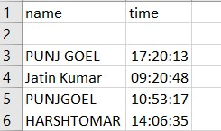
RESULTS
https://github.com/Pgoel134/automated-attendence-system
Demo Link

Slide 11

MEET OUR TEAM
.
.
Jatin Kumar worked on this project alone

